Slide 1

Wave Rider Strategies
Week 2- Team 5

Slide 2

Wave Rider Strategies
Garima Sharma
Marco Moras
Maurits Siemonsma
Nicole Pinto

Slide 3
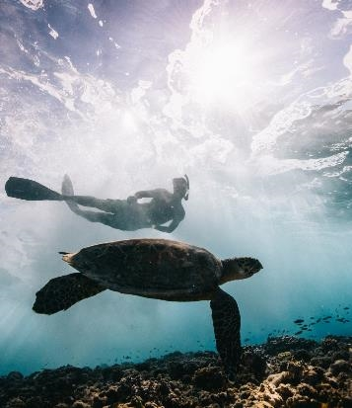
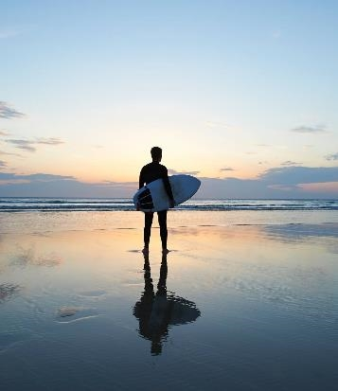

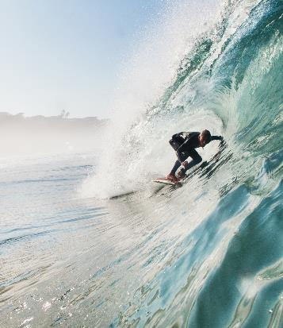
Outline
Background – Business Problem
Project Overview
Data Wrangling
Exploratory Data Analysis
Major Obstacle
Conclusions and Insights

Slide 4



Introduction – Business Problem
Client: OceanSoul Surf Co.
Objective: Assist in expanding and diversifying OceanSoul Surf Co.
Scope: Research and strategic insights for launching a new branch in a new location
Role: Provide essential initial research and guidance
Goal: Ensure informed decision-making and a successful venture launch

Slide 5
Project Overview - Roadmap
Day 1 - Brainstorming
Brainstorming
Data collection
Formulating Hypothesis
Day 2 - Data cleaning
Day 4 - Validate our Hypothesis
Analysis
Validate our Hypothesis
Make the Report
Day 5 - Present
Identifying patterns
Looking for any correlations
Day 3 -Exploratory Data Analysis
Present our Report
Celebrate the completion of the task!!
Removed redundant data
Grouped the data and replaced with common values
Formatting the data

Slide 6

Project Overview
Hypothesis 1
Hypothesis 3
Hypothesis 2
url=https://www.sharkattackfile.net/incidentlog.htm
Unprovoked injuries have a higher fatality rate than provoked injuries
There is a relation between seasons and shark attacks
There is a relation between time of day and shark attacks

Slide 7
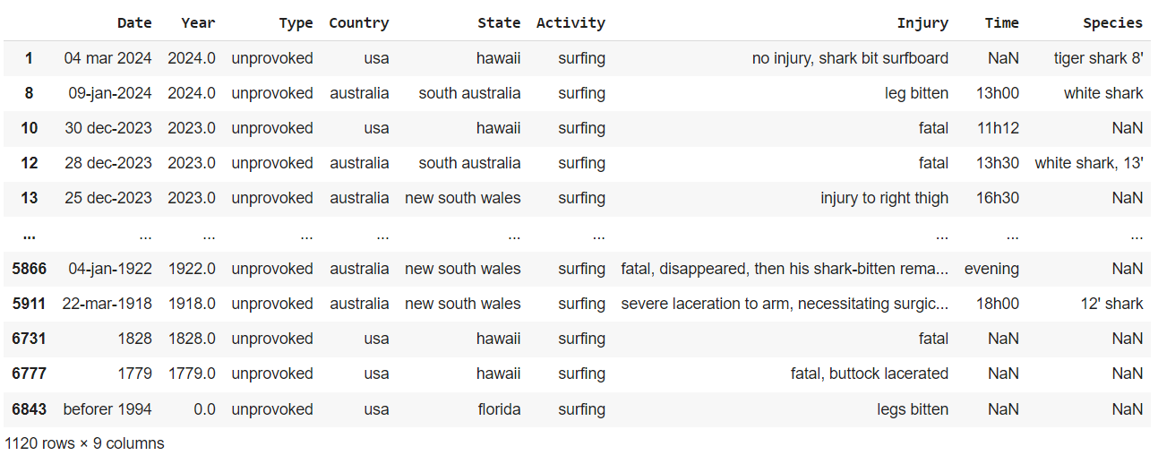
Data Cleaning – The Process
Removed redundant columns
Screened the activity column for ‘surfing’
Checked for nulls, duplicates
Replaced and grouped data to facilitate analysis
1120rows x 9columns

Slide 8
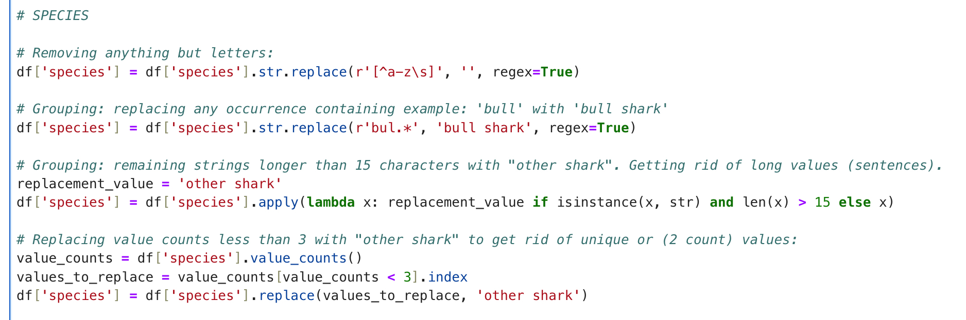
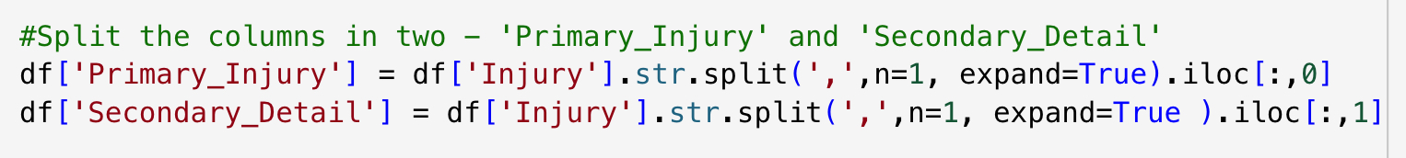
Data Cleaning – Unique Techniques
regex – to find patterns
.str.split() – for better understanding of the primary injury cause

Slide 9
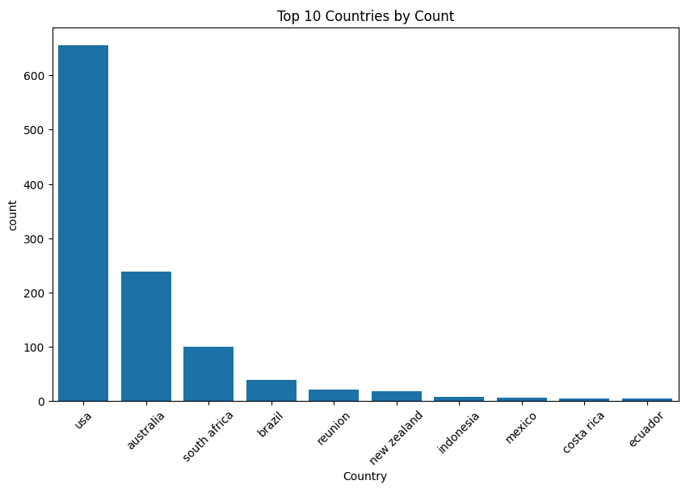
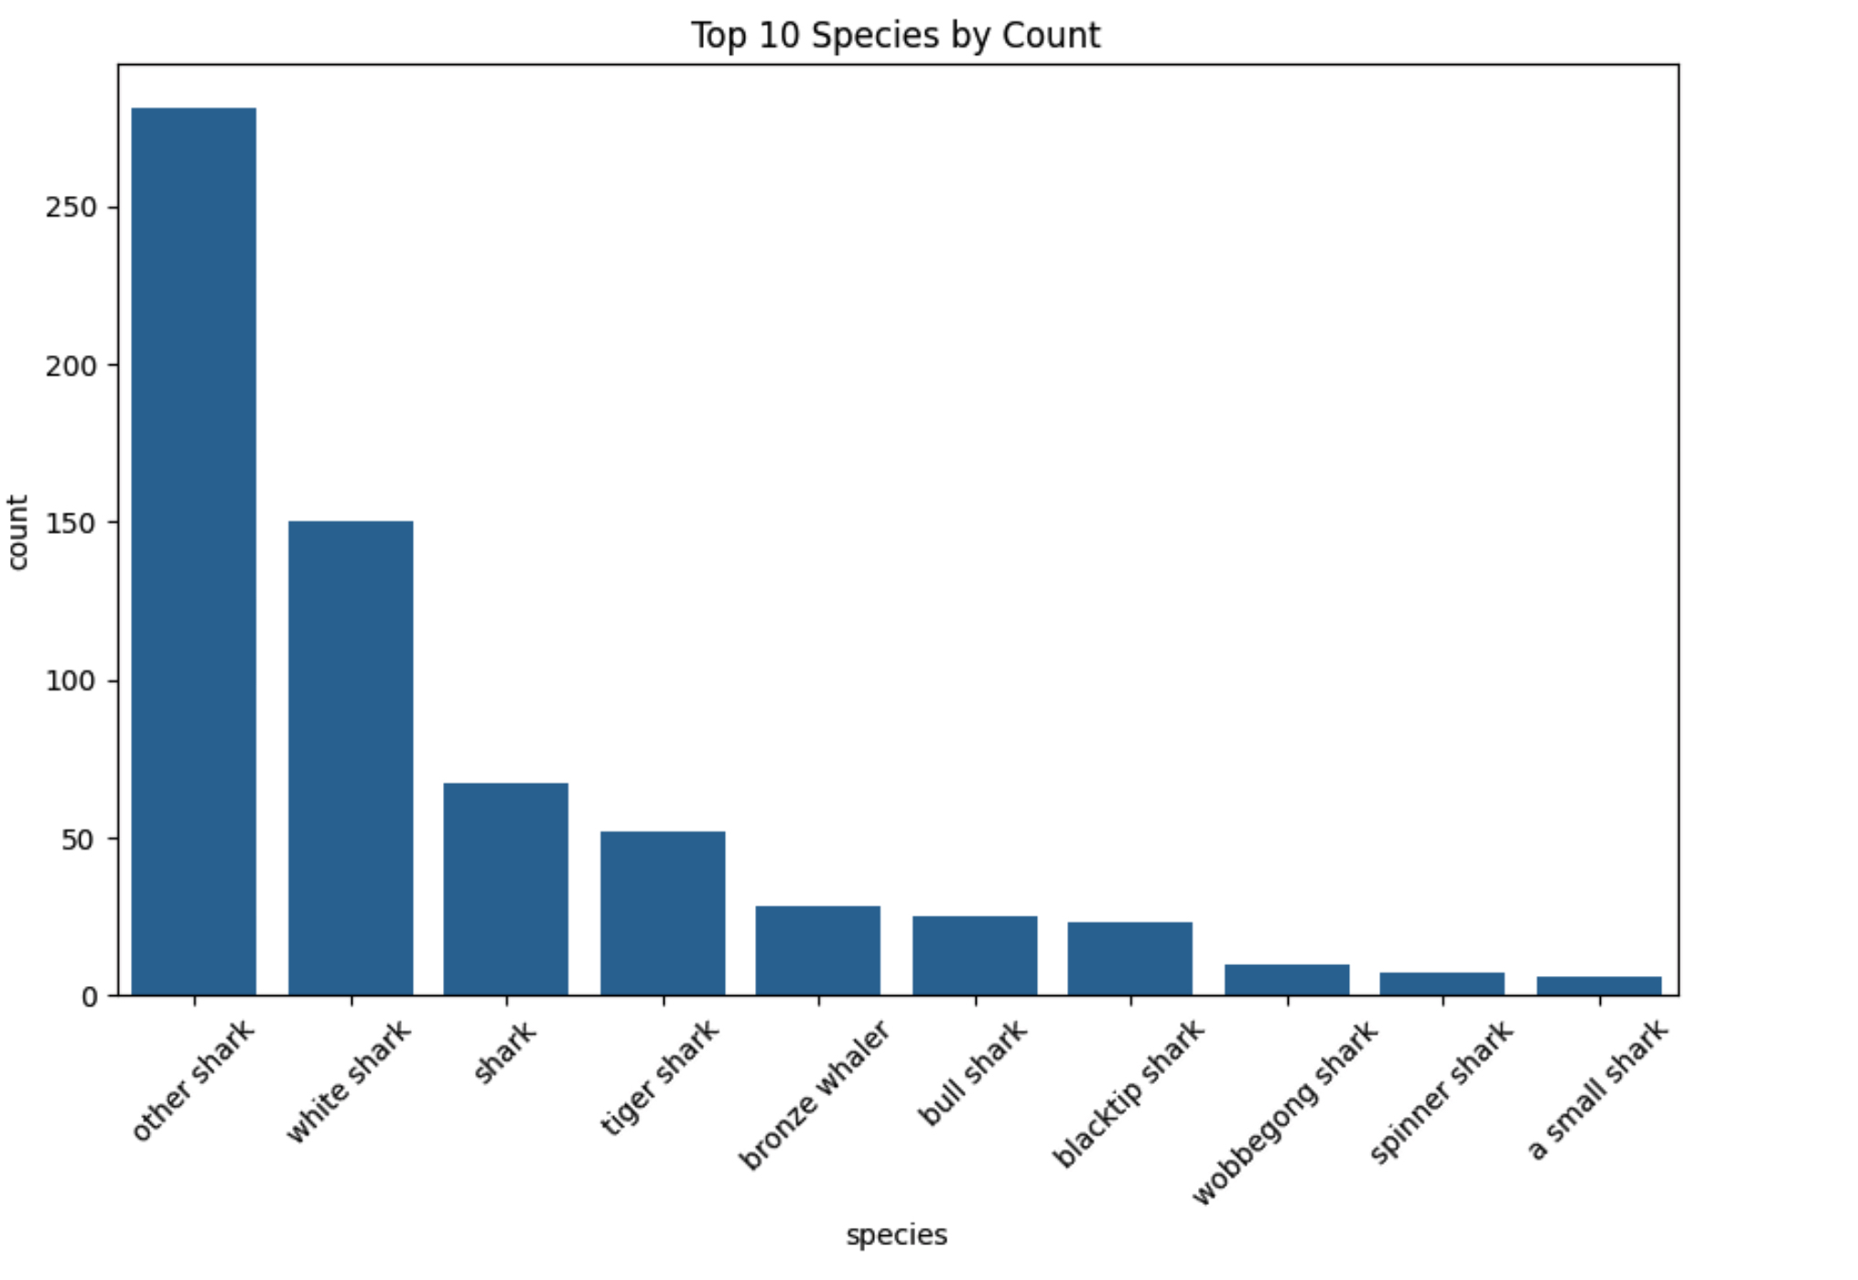
Exploratory Data Analysis
Top 10 Countries occurring in Data Set
Top 10 Attackers

Slide 10
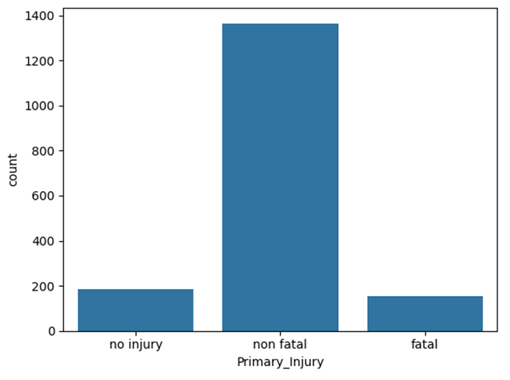
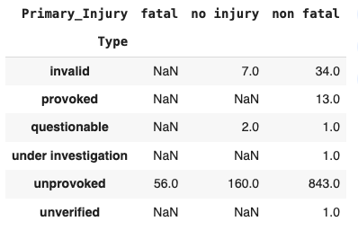
Exploratory Data Analysis
Information about Injuries

Slide 11
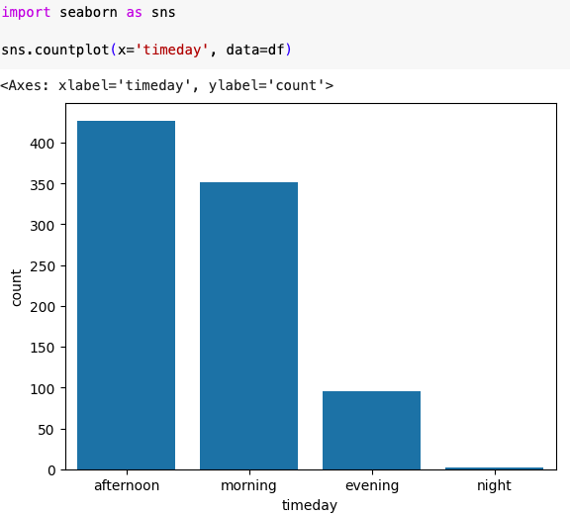
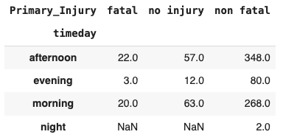
Exploratory Data Analysis
Relation between Time of Day and Primary Injuries

Slide 12
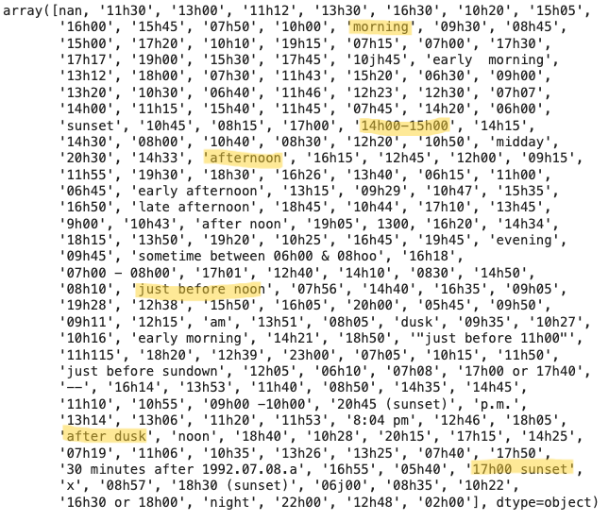
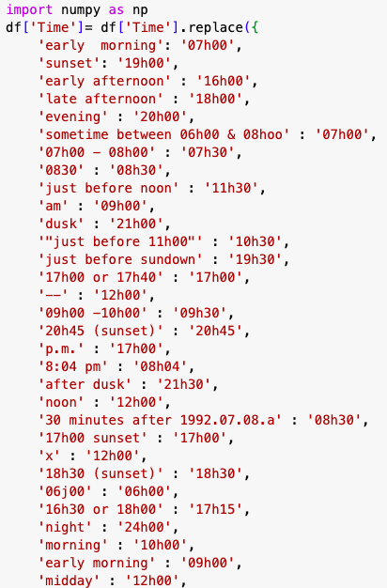
Major Obstacle - Data Cleaning
time column
Too many inconsistences in format and type
Regex replacement - manual replacements

Slide 13
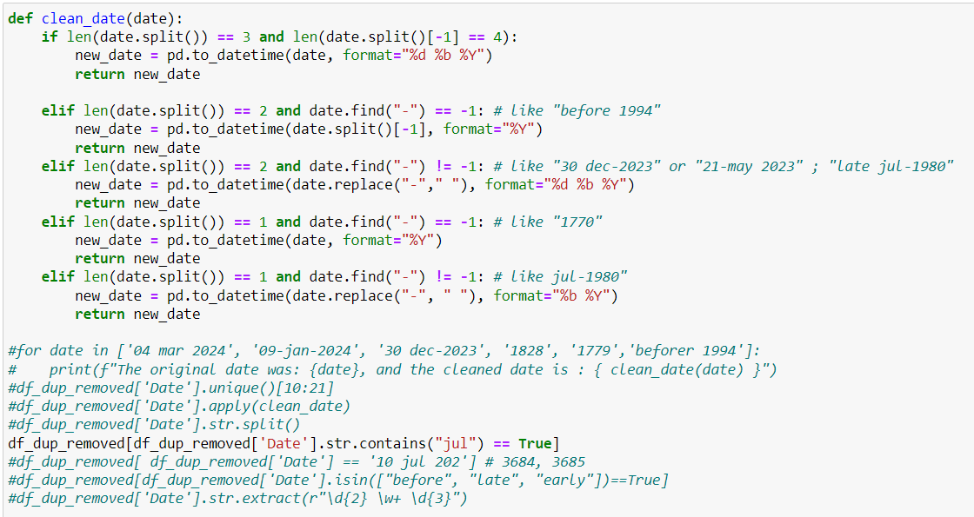
Major Obstacle - Data Cleaning
Date column
Too many inconsistences in format and type
Even though we tried hard to correct, weren’t successful so we decided to drop the column

Slide 14
Conclusion & Insights
Shark Attacks: Most occur in the morning and afternoon; generally non-fatal.
Top Surfing Destination: USA is the surfers' top choice.
Hypotheses Untested: Hypotheses 2 couldn't be tested due to data inconsistencies. Findings: Relation between seasons and shark attacks.
Suggested Improvements: Fatality rates between countries could be analyzed.

Slide 15
Summary
Diversification Strategy
Operational Focus
Market Expansion: OceanSoulSurf Co. should consider expanding their operations within the USA, capitalizing on the country’s popularity among surfers.
Safety USP: Emphasize their unique selling proposition of “Surf with peace of mind, free from the stress of shark attacks” to attract safety-conscious customers.
Safety Measures: Enhance and promote safety measures.
Marketing Strategy: Tailor strategies to emphasize safety and address shark attack concerns.

Slide 16

Thank you

